Slide 1



Predictive Modelling Project
Predicting Depression, Anxiety & Stress based on Personality.
Krupal Patel (20162121007) Yash Prajapati (20162121023)

Slide 2


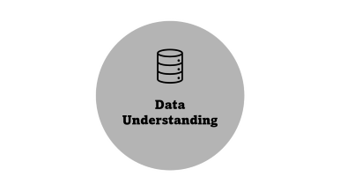
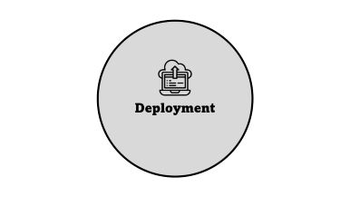
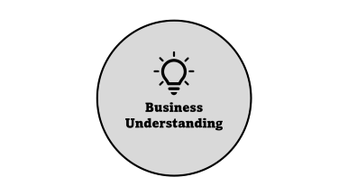
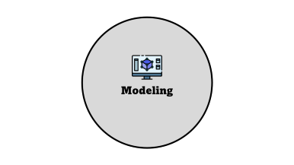
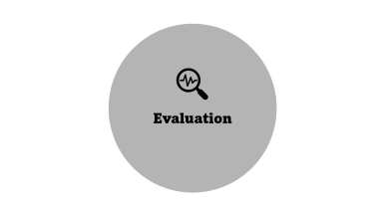
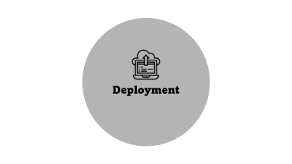
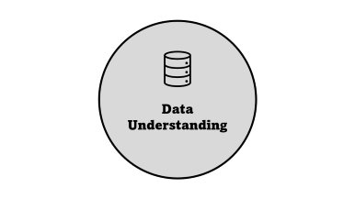
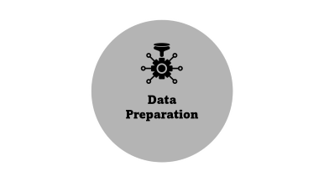
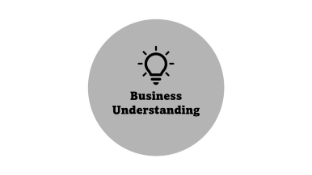
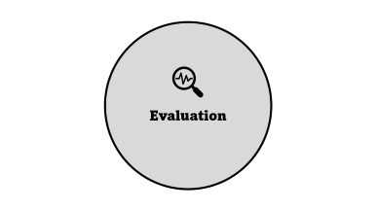
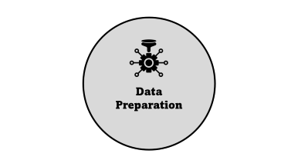
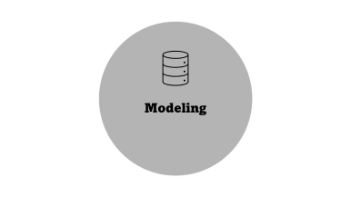
CRISPDM
Data

Slide 3




Krupal Patel 20162121007
Yash Prajapati 20162121023

Slide 4

Business Understanding

Slide 5



Business Understanding
A group of conditions associated with the elevation or lowering of a person’s mood, such as depression or bipolar disorder
Intense, excessive and persistent worry and fear about everyday situations. Fast heart rate, rapid breathing, sweating and feeling tired may occur.
A state of worry or mental tension caused by a difficult situation

Slide 6

Data Understanding

Slide 7





Data Understanding
.csv (comma separated values)
39775 Records
172 Fields
2017 - 2019
There are 42 Question for user to answer for depression, anxiety & stress.
There are 10 questions for checking user’s personality.
There are 16 VCL questions for validity check.
There are other questions to check user’s background.

Slide 8


Depression, Anxiety & Stress: 42 questions options :-
1 = Did not apply to me at all
2 = Applied to me to some degree, or some of the time
3 = Applied to me to a considerable degree, or a good part of the time
4 = Applied to me very much, or most of the time
Data Understanding
Personality: 10 questions :-
TIPI1 Extraverted, enthusiastic.
TIPI2 Critical, quarrelsome.
TIPI3 Dependable, selfdisciplined.
TIPI4 Anxious, easily upset.
TIPI5 Open to new experiences, complex.
TIPI6 Reserved, quiet.
TIPI7 Sympathetic, warm.
TIPI8 Disorganized, careless.
TIPI9 Calm, emotionally stable.
TIPI10 Conventional, uncreative.
Validity check: 16 questions :-
VCL1 boat
VCL2 incoherent
VCL3 pallid
VCL4 robot
VCL5 audible
VCL6 cuivocal
VCL7 paucity
VCL8 epistemology
VCL9 florted
VCL10 decide
VCL11 pastiche
VCL12 verdid
VCL13 abysmal
VCL14 lucid
VCL15 betray
VCL16 funny
DATA
*VCL 6, VCL9 & VCL12 are not real words.

Slide 9

Data Preparation

Slide 10
Data Preparation
Data Validation
Deriving Data
Cleaning Data

Slide 11
Data Validation
Validity check: 16 questions :
VCL1 boat
VCL2 incoherent
VCL3 pallid
VCL4 robot
VCL5 audible
VCL6 cuivocal
VCL7 paucity
VCL8 epistemology
VCL9 florted
VCL10 decide
VCL11 pastiche
VCL12 verdid
VCL13 abysmal
VCL14 lucid
VCL15 betray
VCL16 funny
Data Preparation
* VCL 6, VCL9 & VCL12 are not real words.

Slide 12
Data Preparation
Data Validation
Deriving Data
Cleaning Data

Slide 13
Deriving Data
Deriving Scores for Depression, Anxiety & Stress:-
D_total_sum
A_total_sum
S_total_sum
Q3
Q5
Q10
Q13
Q16
Q17
Q21
Q24
Q26
Q31
Q34
Q37
Q38
Q42
Q2
Q4
Q7
Q9
Q15
Q19
Q20
Q23
Q25
Q28
Q30
Q36
Q40
Q41
Q1
Q6
Q8
Q11
Q12
Q14
Q18
Q22
Q27
Q29
Q32
Q33
Q35
Q39
Data Preparation
Other derived fields :-
age -> agecategory
race -> race / 10
D_labels
A_labels
S_labels

Slide 14
Data Preparation
Data Validation
Deriving Data
Cleaning Data

Slide 15
Cleaning Data
Fields removed :
Q1A to Q42A
Q1E to Q42E
Q1I to Q42I
VCL1 to VCL14
gender
engnat
age
screensize
uniquenetworklocation
hand
orientation
voted
Major
D_total_sum
A_total_sum
S_total_sum
Data Preparation

Slide 16

Modeling

Slide 17

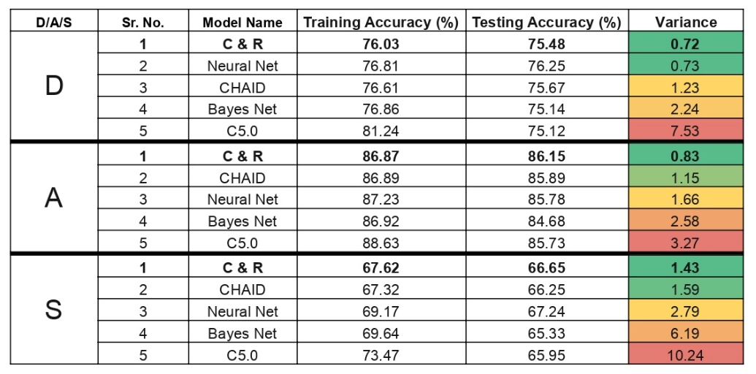
Modeling

Slide 18

Evaluation

Slide 19

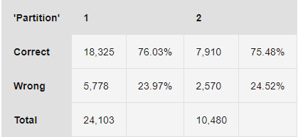
Evaluation
Depression

Slide 20
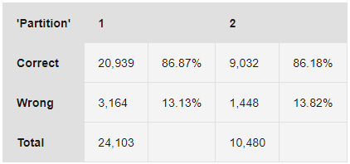
Evaluation
Anxiety

Slide 21
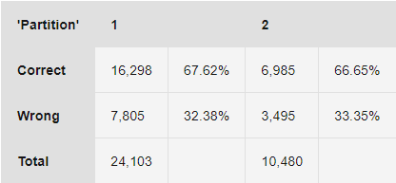
Evaluation
Stress

Slide 22

Deployment

Slide 23





Deployment
Developing Python Script for Model.
Creating a hostable Website.
Adding the Model in backend.
Testing the Model & Website.
Deploying the website.

